Slide 1
Recurrent Neural Networks

Slide 2
Outline
Sequential Data
Recurrent Neural Network
Exploding/Vanishing Gradient Problem

Slide 3
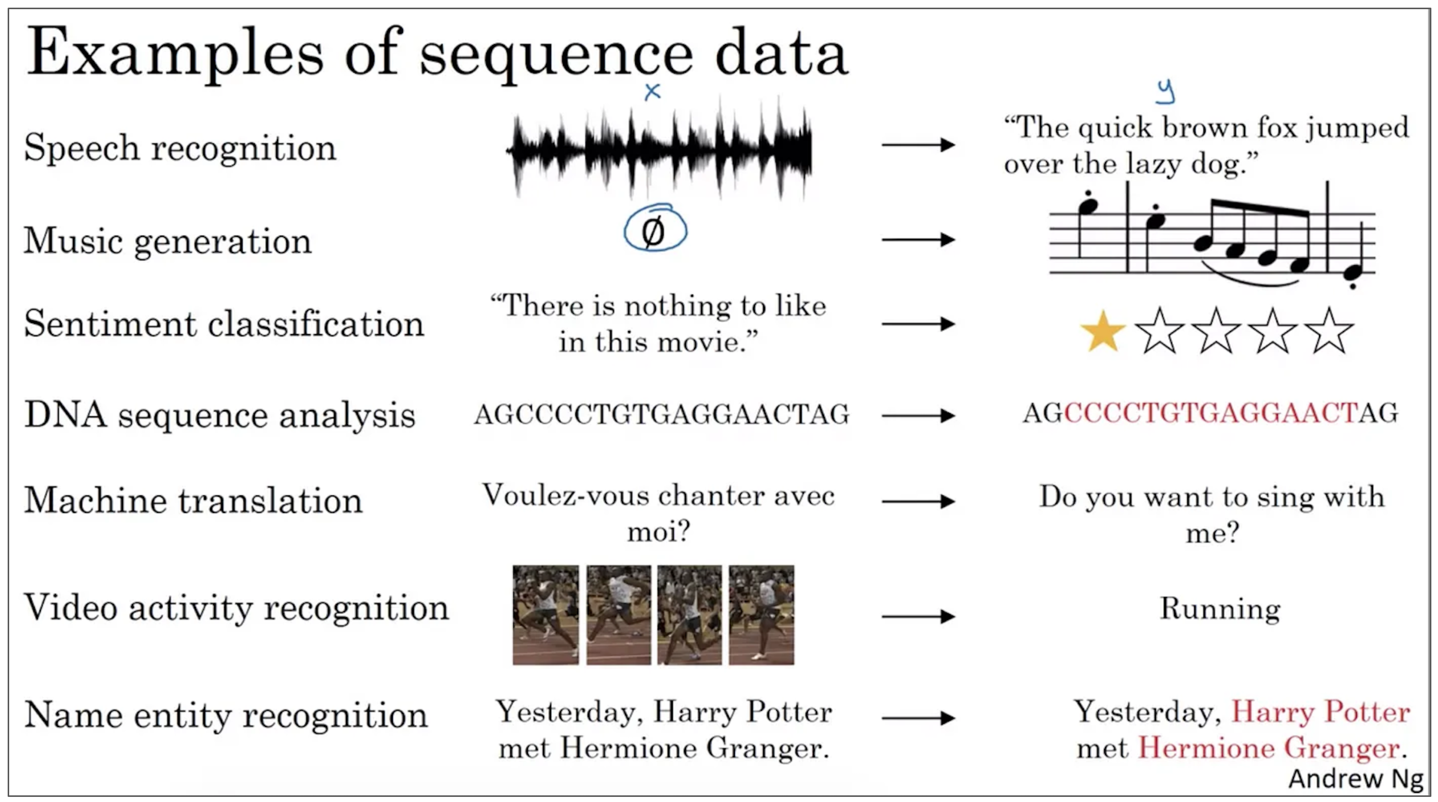
Sequential Data
Sequential data refers to a type of data where the order of elements in important and the elements are typically arranged in a specific sequence or chronological order.

Slide 4
Sequential Data
In sequential data, each element in the sequence is related to the ones that come before and after it and the way these elements are ordered provides context, meaning and structure to the data.

Slide 5
Characteristics of Sequential Data
Order
The arrangement of elements is important. Changing order of elements can lead to different meanings or interpretations.
For example, in NLP, the order of words in a sentence conveys the sentence’s meaning.

Slide 6
Characteristics of Sequential Data
Sequential Relationship
Elements in a sequential data are typically collected or observed in a specific order over time.
Time series data such as stock price records values at different points in time.

Slide 7
Characteristics of Sequential Data
Variable Length
Sequential data can have variable lengths.
In natural language, sentences can be of different lengths.
In genomics, DNA sequences can vary in length depending on the organism

Slide 8
Sequential Data
Price
Year

Slide 9
Examples of Sequential Data
Year | Price
2000 | 100
2001 | 125
2002 | 175
… | …
2025 | 500
Price
Year
Time series data is the most common type of sequential data where measurements are taken at regular intervals over time. Examples include stock prices, temperature readings and sensor data.

Slide 10
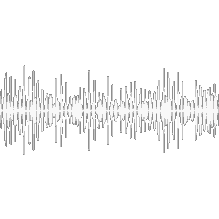
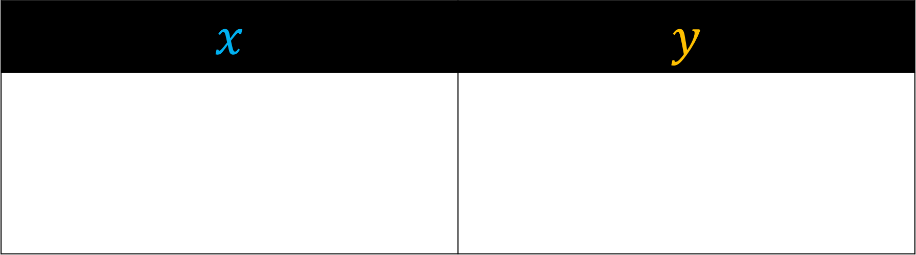
Examples of Sequential Data
$$x$$ | $$y$$
“The quick brown fox jumped over the lazy dog”
For speech recognition, audio signals from spoken languages are sequential, Phonemes, syllables, and words are organized to form sentences.

Slide 11

Examples of Sequential Data
$$x$$ | $$y$$
“The movie is a waste of money”
For sentiment Classification, textual data such as sentences or paragraphs is inherently sequential. The meaning and sentiment of the sentence depend on the order and context of words used.

Slide 12
Examples of Sequential Data
$$x$$ | $$y$$
Voulez-vous chanter avec moi?
Do you want to sing with me?
For machine translation, textual data such as sentences or paragraphs is inherently sequential. The order of words carries important context and grammatical meaning that must be preserved for accurate translation.

Slide 13
Examples of Sequential Data
$$x$$ | $$y$$
Yesterday, Harry Potter met Hermione Granger.
Yesterday, Harry Potter met Hermione Granger.
For name entity recognition, the order of words in textual data matters to identify entities in a paragraph as the meaning and classification of each word depend on its surrounding context and position within the sentence.

Slide 14
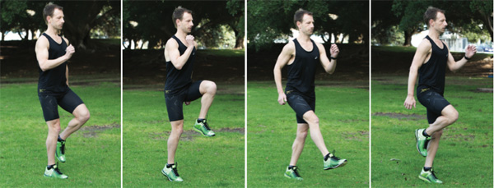
Examples of Sequential Data
$$x$$ | $$y$$
Running
For video activity recognition, video data is composed of frames that serve as a snapshot of a scene at a specific time. The sequence of frames creates the illusion of motion.

Slide 15
Price
Day
As an example, let us talk about stock market data in general.

Slide 16
Price
Day
When we look at stock prices, they tend to change over time.

Slide 17
Price
Day
In our example, Google’s stock price gradually increased from day 1 to day 4 but it fell in day 5.

Slide 18
Price
Day
Also, the longer a company has been traded on the stock market, the more data we will have for it.

Slide 19
Price
Day
In this example, we have more time series data for Google than we have for Facebook

Slide 20
Price
Day
What this means is, if we want a neural network to predict stock prices, then we need a neural network that works with sequential data with variable lengths.

Slide 21


Price
Day
In other words, if we want to predict the stock price for Google on day 10

Slide 22

Price
Day
Then we might want to use the data from all 9 of the preceding days.

Slide 23


Price
Day
In contrast, if we want to predict the stock price for Facebook on day 10, then we would only have data for the preceding 5 days.

Slide 24
Price
Day
So we need a neural network to be flexible in terms of how much sequential data we use to make a prediction.

Slide 25
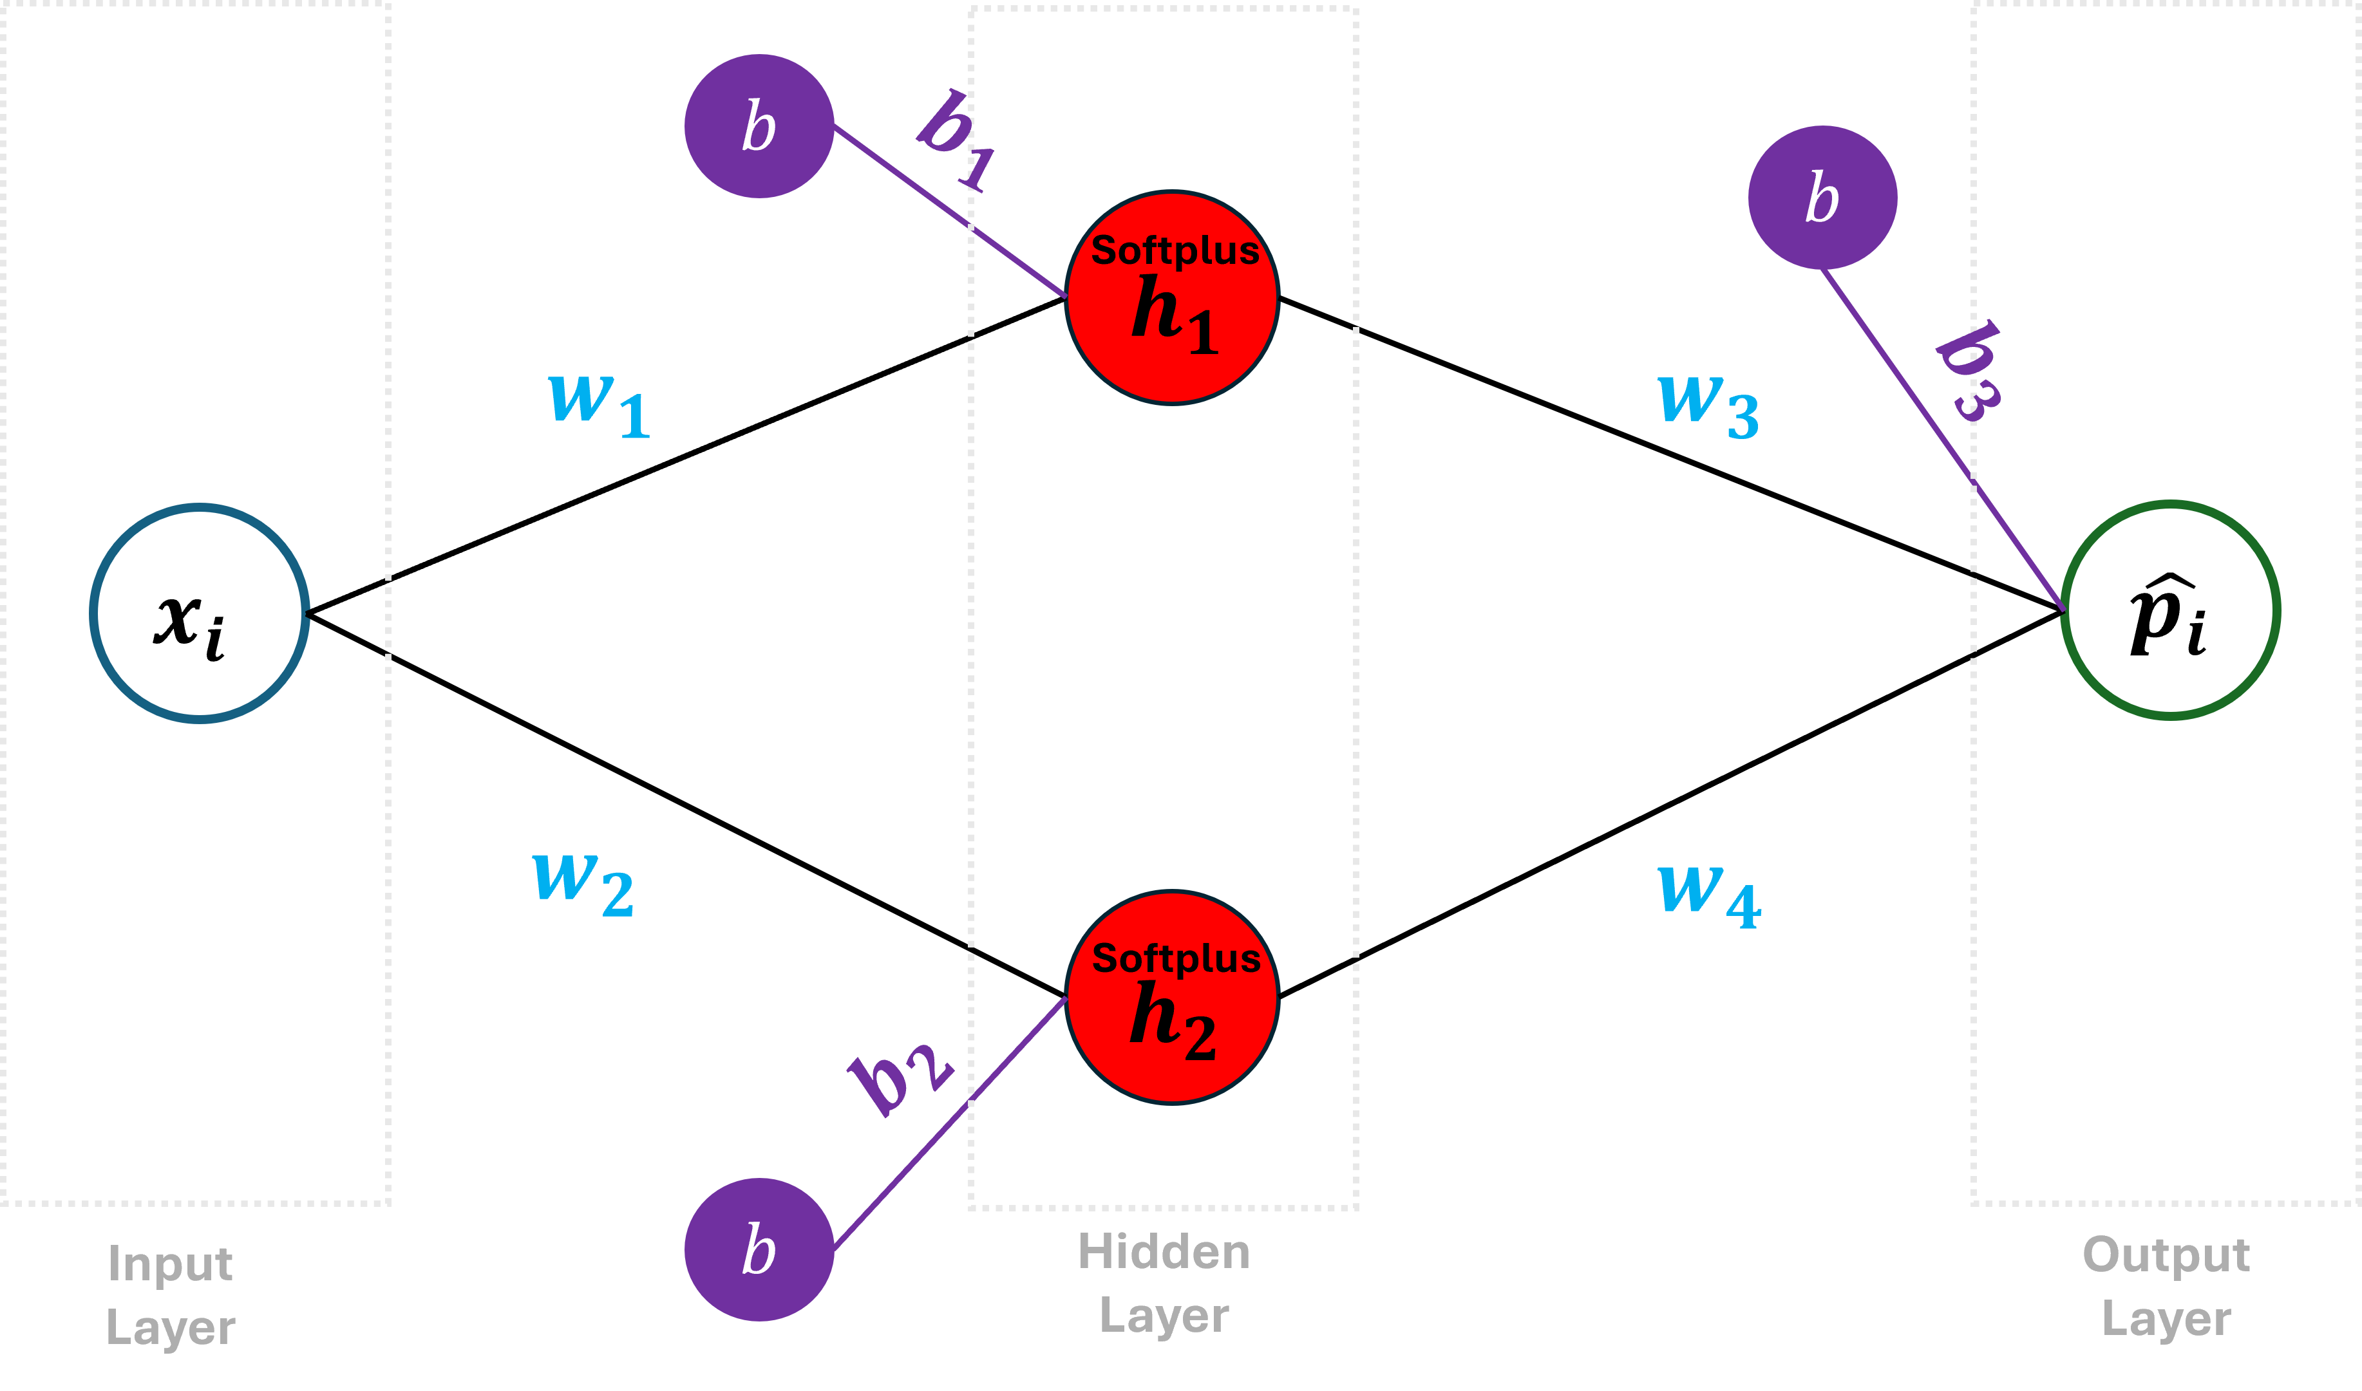
Going back to our introduction to neural networks, we examined a neural network that made predictions using 1 input value, no more, no less.

Slide 26
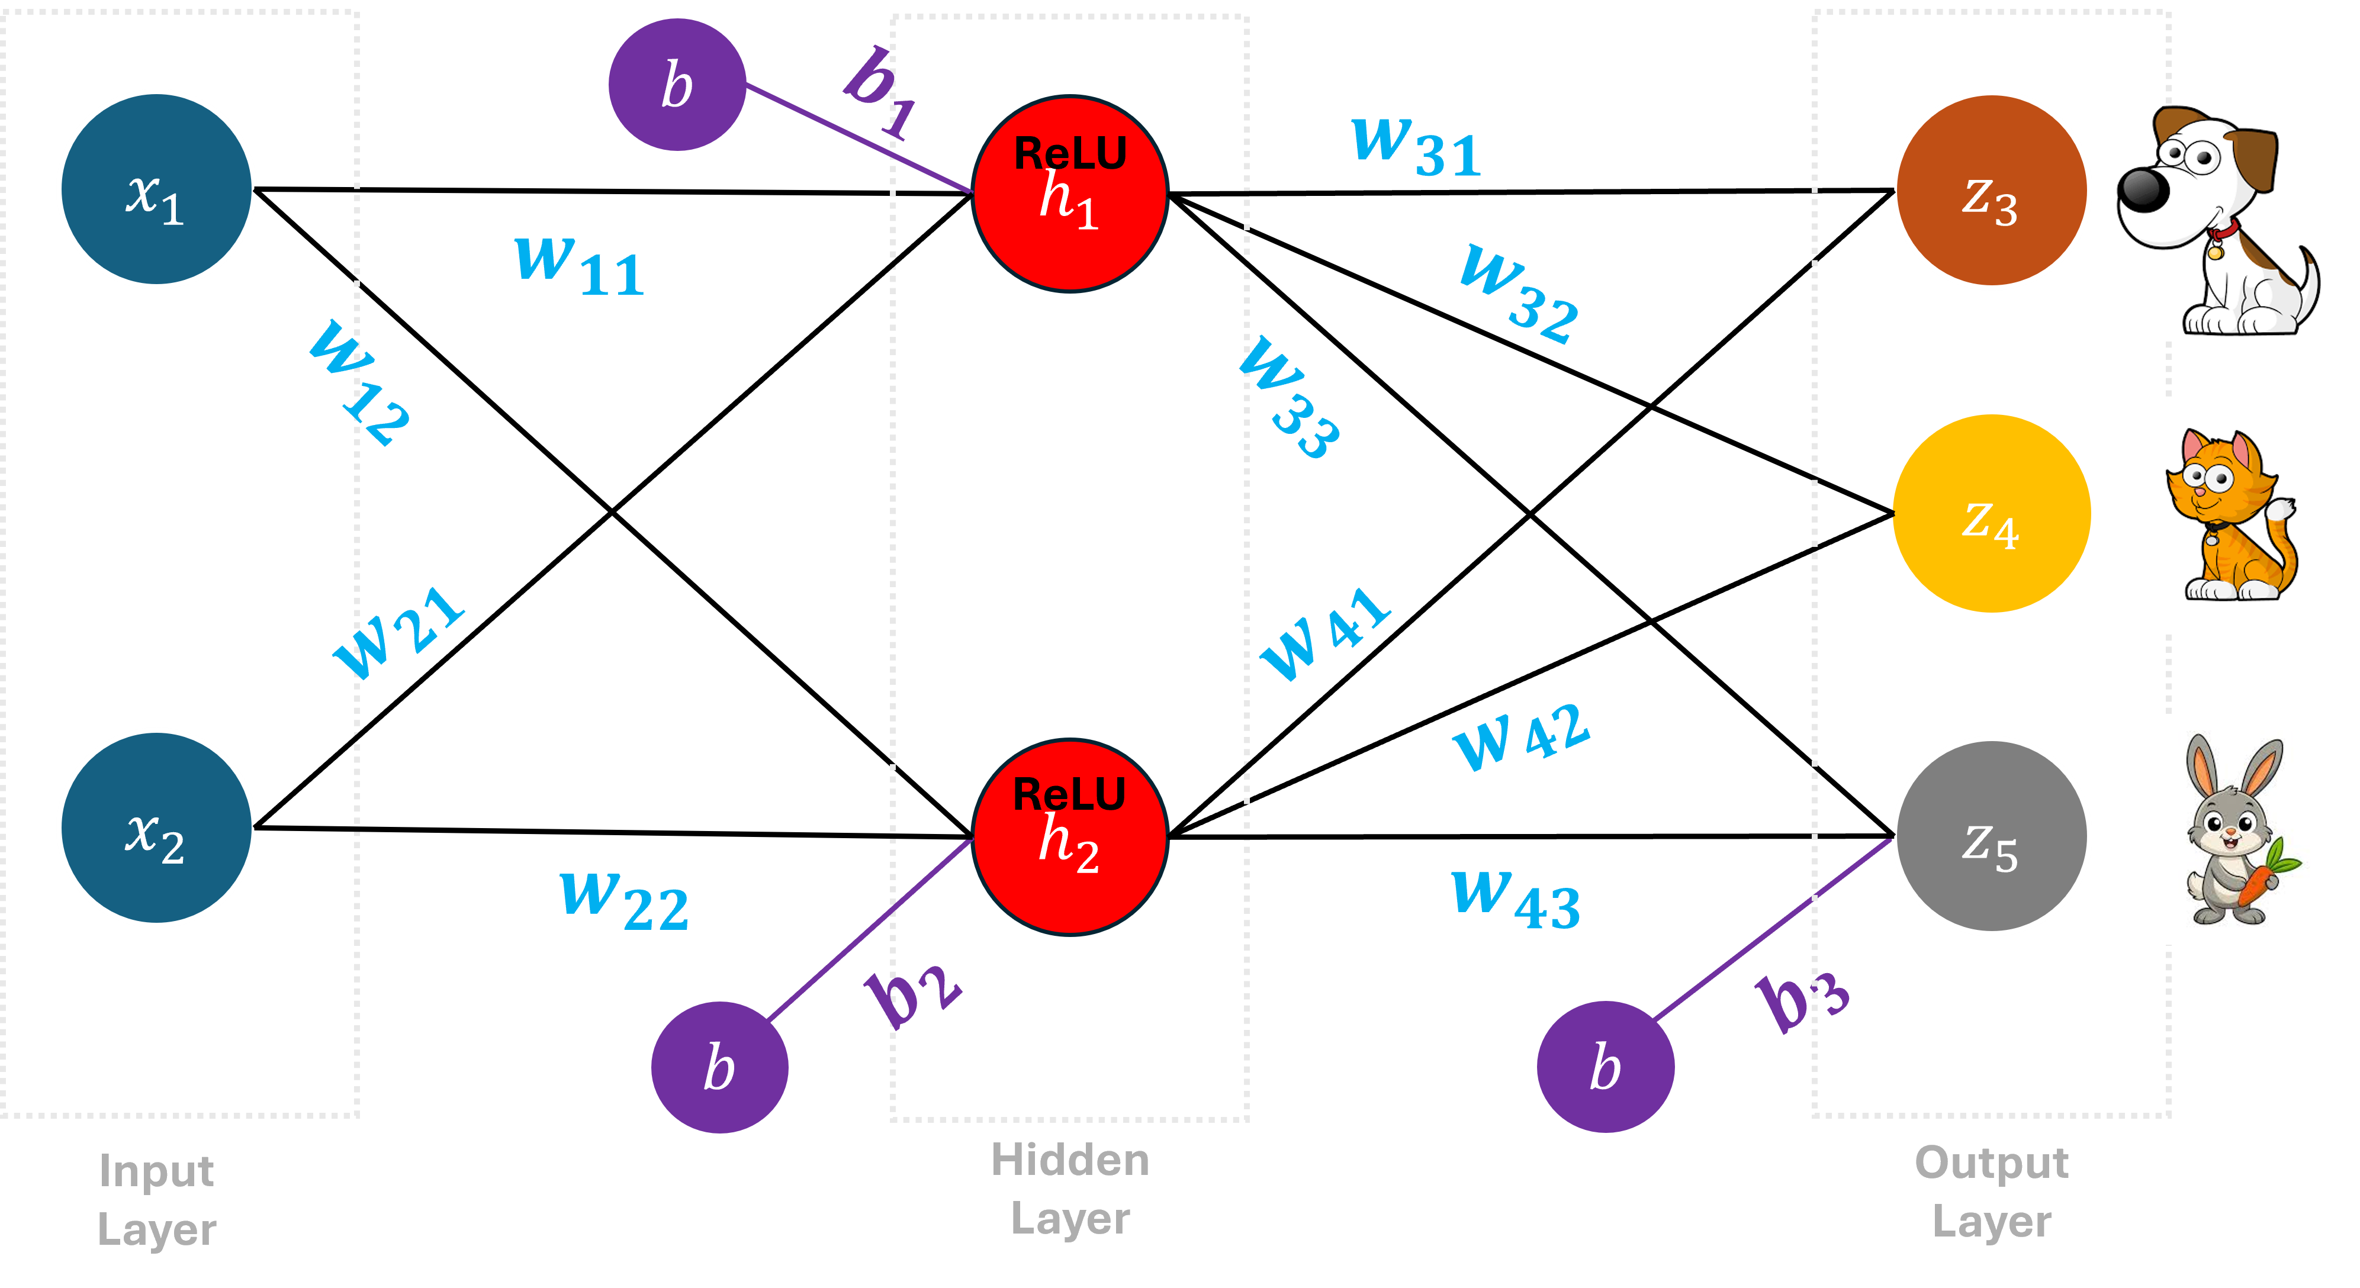
Also, in our softmax activation lecture, we saw a neural network that made predictions using 2 input values, no more, no less.

Slide 27
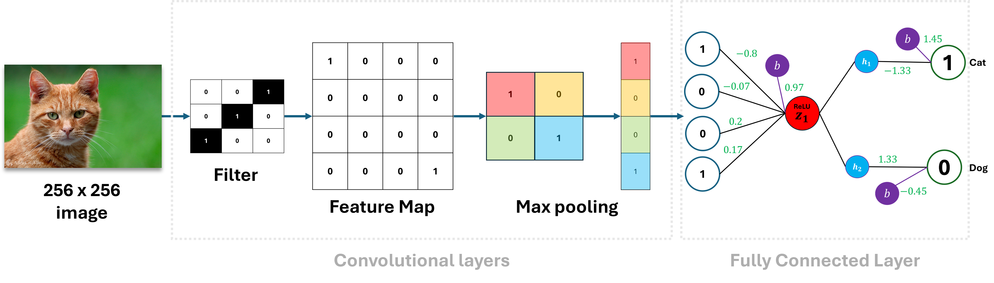
And in our convolutional neural network lecture, we saw a neural network that made a prediction using an image that has a fixed size (e.g 256 x 256), no bigger, no smaller.

Slide 28
Price
Day
However, now we need a neural network that can make a prediction using the 9 values we have for Google, and 5 values we have for Facebook

Slide 29
Price
Day
The good news is that one way to deal with the problem of handling sequential data with variable lengths is to use a Recurrent Neural Network(RNN)

Slide 30
Price
Price
Day
Day
Price
Price
Day
Day

Slide 31
Price
Yesterday
Today
Tomorrow
Day
To demonstrate how RNNs handle sequential data, we will use this simple example.

Slide 32
Price
Yesterday
Today
Tomorrow
Day
This is the real-world observation. We can see a trend that the stock price goes up each day.

Slide 33
Price
Yesterday
Today
Tomorrow
Day
Let us try to model this using RNNs and see if we can use yesterday and today’s data to predict tomorrow’s price

Slide 34
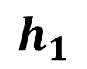
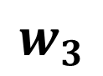
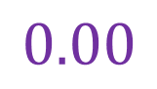

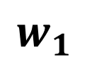

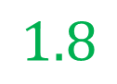
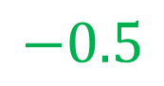

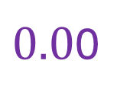
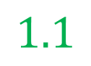
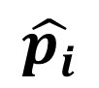
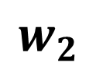
$$w_{1}$$
$$w_{3}$$
$${ x}_{i}$$
$$1.8$$
$$0.00$$
$$1.1$$
$0.0$0
$${ b}_{1}$$
ReLu
$${ b}_{2}$$
$$\hat{p_{i}}$$
$$h_{1}$$
Input Layer
Hidden Layer
$$w_{2}$$
Output Layer
$$−0.5$$
Just like other neural networks, RNNs have weights and biases, layers and activation functions.

Slide 35
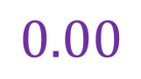
$$w_{1}$$
$$w_{3}$$
$${ x}_{i}$$
$$1.8$$
$$0.00$$
$$1.1$$
$$0.00$$
$${ b}_{1}$$
ReLu
$${ b}_{2}$$
$$\hat{p_{i}}$$
$$h_{1}$$
Input Layer
Hidden Layer
$$w_{2}$$
Output Layer
$$−0.5$$
The main difference is that RNNs have feedback loops.

Slide 36
$$w_{1}$$
$$w_{3}$$
$${ x}_{i}$$
$$1.8$$
$$0.00$$
$$1.1$$
$$0.00$$
$${ b}_{1}$$
ReLu
$${ b}_{2}$$
$$\hat{p_{i}}$$
$$h_{1}$$
Input Layer
Hidden Layer
$$w_{2}$$
Output Layer
$$−0.5$$
The feedback loop allows both yesterday and today’s stock prices to influence the prediction of tomorrow’s stock price.

Slide 37
$$w_{1}$$
$$w_{3}$$
$${ x}_{i}$$
$$1.8$$
$$0.00$$
$$1.1$$
$$0.00$$
$${ b}_{1}$$
ReLu
$${ b}_{2}$$
$$\hat{p_{i}}$$
$$h_{1}$$
Input Layer
Hidden Layer
$$w_{2}$$
Output Layer
$$−0.5$$
To make it easier to understand what a feedback loop does in a recurrent neural network…

Slide 38
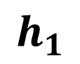
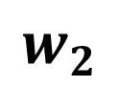
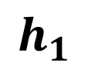
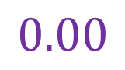
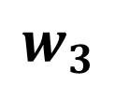

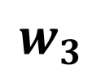

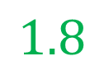
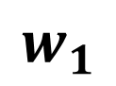
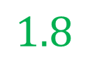
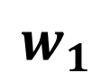

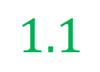
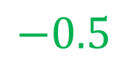
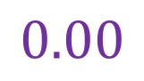
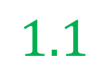
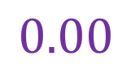


$$w_{1}$$
$$w_{3}$$
$$1.8$$
$$0.00$$
$$1.1$$
$$0.00$$
$${ b}_{1}$$
ReLu
$${ b}_{2}$$
$$h_{1}$$
Input
Output
$$w_{2}$$
$$−0.5$$
$$w_{1}$$
$$w_{3}$$
$$1.8$$
$$0.00$$
$$1.1$$
$$0.00$$
$${ b}_{1}$$
ReLu
$${ b}_{2}$$
$$h_{1}$$
Input
Output
We can unroll the feedback loop by making a copy of the neural network for each input value.

Slide 39
$$w_{1}$$
$$w_{3}$$
$$1.8$$
$$0.00$$
$$1.1$$
$$0.00$$
$${ b}_{1}$$
ReLu
$${ b}_{2}$$
$$h_{1}$$
Input
Output
$$w_{2}$$
$$−0.5$$
$$w_{1}$$
$$w_{3}$$
$$1.8$$
$$0.00$$
$$1.1$$
$$0.00$$
$${ b}_{1}$$
ReLu
$${ b}_{2}$$
$$h_{1}$$
Input
Output
Instead of pointing the feedback loop to the sum in the first copy…

Slide 40
$$w_{1}$$
$$w_{3}$$
$$1.8$$
$$0.00$$
$$1.1$$
$$0.00$$
$${ b}_{1}$$
ReLu
$${ b}_{2}$$
$$h_{1}$$
Input
Output
$$w_{2}$$
$$−0.5$$
$$w_{1}$$
$$w_{3}$$
$$1.8$$
$$0.00$$
$$1.1$$
$$0.00$$
$${ b}_{1}$$
ReLu
$${ b}_{2}$$
$$h_{1}$$
Input
Output
We can point the feedback loop to the sum in the second copy

Slide 41
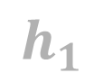
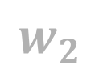

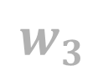





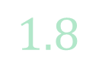





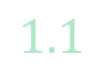



$$w_{1}$$
$$w_{3}$$
$$1.8$$
$$0.00$$
$$1.1$$
$$0.00$$
$${ b}_{1}$$
ReLu
$${ b}_{2}$$
$$h_{1}$$
Input
Output
$$w_{2}$$
$$−0.5$$
$$w_{1}$$
$$w_{3}$$
$$1.8$$
$$0.00$$
$$1.1$$
$$0.00$$
$${ b}_{1}$$
ReLu
$${ b}_{2}$$
$$h_{1}$$
Input
Output
By unrolling the recurrent neural network, we end up with a new network that has two inputs..

Slide 42


$$w_{1}$$
$$w_{3}$$
$$1.8$$
$$0.00$$
$$1.1$$
$$0.00$$
$${ b}_{1}$$
ReLu
$${ b}_{2}$$
$$h_{1}$$
Input
Output
$$w_{2}$$
$$−0.5$$
$$w_{1}$$
$$w_{3}$$
$$1.8$$
$$0.00$$
$$1.1$$
$$0.00$$
$${ b}_{1}$$
ReLu
$${ b}_{2}$$
$$h_{1}$$
Input
Output
And two outputs

Slide 43
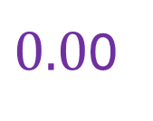
$$w_{1}$$
$$w_{3}$$
$$1.8$$
$$0.00$$
$$1.1$$
$$0.00$$
$${ b}_{1}$$
ReLu
$${ b}_{2}$$
$$h_{1}$$
Input
Output
$$w_{2}$$
$$−0.5$$
$$w_{1}$$
$$w_{3}$$
$$1.8$$
$$0.00$$
$$1.1$$
$0.0$0
$${ b}_{1}$$
ReLu
$${ b}_{2}$$
$$h_{1}$$
Input
Output
Let us run our inputs to our recurrent neural network to see how it uses yesterday’s stock price and today’s stock price…

Slide 44
$$w_{1}$$
$$w_{3}$$
$$1.8$$
$$0.00$$
$$1.1$$
$$0.00$$
$${ b}_{1}$$
ReLu
$${ b}_{2}$$
$$h_{1}$$
Input
Output
$$w_{2}$$
$$−0.5$$
$$w_{1}$$
$$w_{3}$$
$$1.8$$
$$0.00$$
$$1.1$$
$0.0$0
$${ b}_{1}$$
ReLu
$${ b}_{2}$$
$$h_{1}$$
Input
Output
To predict tomorrow’s stock price and how they influence it.

Slide 45

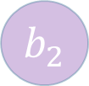


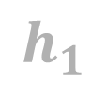
$$w_{1}$$
$$w_{3}$$
$$0$$
$$1.8$$
$$0.00$$
$$1.1$$
$$0.00$$
$${ b}_{1}$$
ReLu
$${ b}_{2}$$
$$h_{1}$$
Yesterday’s
Price
Today’s predicted
price
$$w_{2}$$
$$−0.5$$
$$w_{1}$$
$$w_{3}$$
$$1.8$$
$$0.00$$
$$1.1$$
$$0.00$$
$${ b}_{1}$$
ReLu
$${ b}_{2}$$
$$h_{1}$$
Today’s
Price
Tomorrow’s predicted
price
The first input will be yesterday’s stock price. If we do the math…

Slide 46
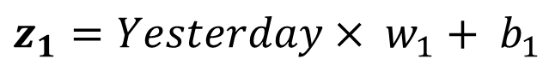
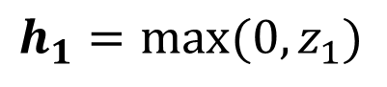
$$w_{1}$$
$$w_{3}$$
$$0$$
$$1.8$$
$$0.00$$
$$1.1$$
$$0.00$$
$${ b}_{1}$$
ReLu
$${ b}_{2}$$
$$h_{1}$$
Yesterday’s
Price
Today’s predicted
price
$$w_{2}$$
$$−0.5$$
$$w_{1}$$
$$w_{3}$$
$$1.8$$
$$0.00$$
$$1.1$$
$$0.00$$
$${ b}_{1}$$
ReLu
$${ b}_{2}$$
$$h_{1}$$
Today’s
Price
Tomorrow’s predicted
price
$$z_{1}=Yesterday× w_{1}+ b_{1}$$
$$h_{1}=max⁡(0,z_{1})$$

Slide 47
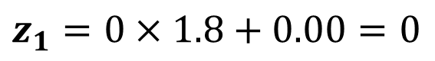
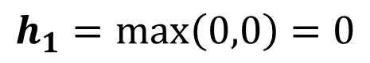
$$w_{1}$$
$$w_{3}$$
$$0$$
$$1.8$$
$$0.00$$
$$1.1$$
$$0.00$$
$${ b}_{1}$$
ReLu
$${ b}_{2}$$
$$h_{1}$$
Yesterday’s
Price
Today’s predicted
price
$$w_{2}$$
$$−0.5$$
$$w_{1}$$
$$w_{3}$$
$$1.8$$
$$0.00$$
$$1.1$$
$$0.00$$
$${ b}_{1}$$
ReLu
$${ b}_{2}$$
$$h_{1}$$
Today’s
Price
Tomorrow’s predicted
price
$$z_{1}=0×1.8+0.00=0$$
$$h_{1}=\max\left(0,0\right)=0$$

Slide 48

$$w_{1}$$
$$w_{3}$$
$$0$$
$$1.8$$
$$0.00$$
$$1.1$$
$$0.00$$
$${ b}_{1}$$
ReLu
$${ b}_{2}$$
$$h_{1}$$
Yesterday’s
Price
Today’s predicted
price
$$w_{2}$$
$$−0.5$$
$$w_{1}$$
$$w_{3}$$
$$1.8$$
$$0.00$$
$$1.1$$
$$0.00$$
$${ b}_{1}$$
ReLu
$${ b}_{2}$$
$$h_{1}$$
Today’s
Price
Tomorrow’s predicted
price

Slide 49
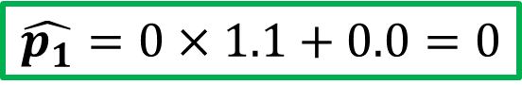
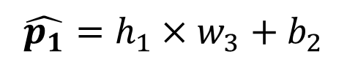
$$w_{1}$$
$$w_{3}$$
$$0$$
$$1.8$$
$$0.00$$
$$1.1$$
$$0.00$$
0
$${ b}_{1}$$
ReLu
$${ b}_{2}$$
$$h_{1}$$
Yesterday’s
Price
Today’s predicted
price
$$w_{2}$$
$$−0.5$$
$$w_{1}$$
$$w_{3}$$
$$1.8$$
$$0.00$$
$$1.1$$
$$0.00$$
$${ b}_{1}$$
ReLu
$${ b}_{2}$$
$$h_{1}$$
Today’s
Price
Tomorrow’s predicted
price
$$\hat{p_{1}}=h_{1}×w_{3}+b_{2}$$
$$\hat{p_{1}}=0×1.1+0.0=0$$

Slide 50
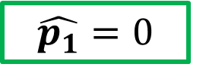
$$w_{1}$$
$$w_{3}$$
$$0$$
$$1.8$$
$$0.00$$
$$1.1$$
$$0.00$$
0
$${ b}_{1}$$
ReLu
$${ b}_{2}$$
$$h_{1}$$
Yesterday’s
Price
Today’s predicted
price
$$w_{2}$$
$$−0.5$$
$$w_{1}$$
$$w_{3}$$
$$1.8$$
$$0.00$$
$$1.1$$
$$0.00$$
$${ b}_{1}$$
ReLu
$${ b}_{2}$$
$$h_{1}$$
Today’s
Price
Tomorrow’s predicted
price
We get the predicted value for today’s stock price
$$\hat{p_{1}}=0$$

Slide 51
$$w_{1}$$
$$w_{3}$$
$$0$$
$$1.8$$
$$0.00$$
$$1.1$$
$$0.00$$
0
$${ b}_{1}$$
ReLu
$${ b}_{2}$$
$$h_{1}$$
Yesterday’s
Price
Today’s predicted
price
$$w_{2}$$
$$−0.5$$
$$w_{1}$$
$$w_{3}$$
$$1.8$$
$$0.00$$
$$1.1$$
$$0.00$$
$${ b}_{1}$$
ReLu
$${ b}_{2}$$
$$h_{1}$$
Today’s
Price
Tomorrow’s predicted
price
However, we are not interested in today’s predicted price because we already have the actual value for today’s stock price

Slide 52
$$w_{1}$$
$$w_{3}$$
$$0$$
$$1.8$$
$$0.00$$
$$1.1$$
$$0.00$$
0
$${ b}_{1}$$
ReLu
$${ b}_{2}$$
$$h_{1}$$
Yesterday’s
Price
Today’s predicted
price
$$w_{2}$$
$$−0.5$$
$$w_{1}$$
$$w_{3}$$
$$1.8$$
$$0.00$$
$$1.1$$
$$0.00$$
$${ b}_{1}$$
ReLu
$${ b}_{2}$$
$$h_{1}$$
Today’s
Price
Tomorrow’s predicted
price
Instead, we want to use both yesterday and today’s value to predict tomorrow’s value. So we can ignore it.

Slide 53
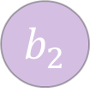
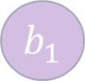



$$w_{1}$$
$$w_{3}$$
$$0$$
$$1.8$$
$$0.00$$
$$1.1$$
$$0.00$$
$${ b}_{1}$$
ReLu
$${ b}_{2}$$
$$h_{1}$$
Yesterday’s
Price
Today’s predicted
price
$$w_{2}$$
$$−0.5$$
$$w_{1}$$
$$w_{3}$$
$$0.5$$
$$1.8$$
$$0.00$$
$$1.1$$
$$0.00$$
$${ b}_{1}$$
ReLu
$${ b}_{2}$$
$$h_{1}$$
Today’s
Price
Tomorrow’s predicted
price
Now we put today’s stock price into the second input and do the math..

Slide 54


$$w_{1}$$
$$w_{3}$$
$$0$$
$$1.8$$
$$0.00$$
$$1.1$$
$$0.00$$
$${ b}_{1}$$
ReLu
$${ b}_{2}$$
$$h_{1}$$
Yesterday’s
Price
Today’s predicted
price
$$w_{2}$$
$$−0.5$$
$$w_{1}$$
$$w_{3}$$
$$0.5$$
$$1.8$$
$$0.00$$
$$1.1$$
$$0.00$$
$${ b}_{1}$$
ReLu
$${ b}_{2}$$
$$h_{1}$$
Today’s
Price
Tomorrow’s predicted
price
Remember that the feedback loop serves as a connection between the first activation function and the second summation to allow both yesterday and today’s value to influence the final output.

Slide 55
$$w_{1}$$
$$w_{3}$$
$$0$$
$$1.8$$
$$0.00$$
$$1.1$$
$$0.00$$
$${ b}_{1}$$
ReLu
$${ b}_{2}$$
$$h_{1}$$
Yesterday’s
Price
Today’s predicted
price
$$w_{2}$$
$$−0.5$$
$$w_{1}$$
$$w_{3}$$
$$0.5$$
$$1.8$$
$$0.00$$
$$1.1$$
$$0.00$$
$${ b}_{1}$$
ReLu
$${ b}_{2}$$
$$h_{1}$$
Today’s
Price
Tomorrow’s predicted
price
If we do the math…

Slide 56





$$w_{1}$$
$$w_{3}$$
$$0$$
$$1.8$$
$$0.00$$
$$1.1$$
$0.0$0
0
$${ b}_{1}$$
ReLu
$${ b}_{2}$$
$$h_{1}$$
Yesterday’s
Price
Today’s predicted
price
$$w_{2}$$
$$−0.5$$
$$w_{1}$$
$$w_{3}$$
$$0.5$$
$$1.8$$
$$0.00$$
$$1.1$$
$0.0$0
$${ b}_{1}$$
ReLu
$${ b}_{2}$$
$$h_{1}$$
Today’s
Price
Tomorrow’s predicted
price
$$z_{2}=Today×w_{1}+\left(h_{1}×w_{2}\right)+b_{1}$$
$$h_{2}=max⁡(0,z_{2})$$

Slide 57

$$w_{1}$$
$$w_{3}$$
$$0$$
$$1.8$$
$$0.00$$
$$1.1$$
$$0.00$$
0
$${ b}_{1}$$
ReLu
$${ b}_{2}$$
$$h_{1}$$
Yesterday’s
Price
Today’s predicted
price
$$w_{2}$$
$$−0.5$$
$$w_{1}$$
$$w_{3}$$
$$0.5$$
$$1.8$$
$$0.00$$
$$1.1$$
$$0.00$$
$${ b}_{1}$$
ReLu
$${ b}_{2}$$
$$h_{1}$$
Today’s
Price
Tomorrow’s predicted
price
$$z_{2}=0.5×1.8+\left(0×−0.5\right)+0.00=0.9$$
$$h_{2}=\max\left(0,0.9\right)=0.9$$

Slide 58



$$w_{1}$$
$$w_{3}$$
$$0$$
$$1.8$$
$$0.00$$
$$1.1$$
$0.0$0
00
$${ b}_{1}$$
ReLu
$${ b}_{2}$$
$$h_{1}$$
Yesterday’s
Price
Today’s predicted
price
$$w_{2}$$
$$−0.5$$
$$w_{1}$$
$$w_{3}$$
$$0.5$$
$$1.8$$
$$0.00$$
$$1.1$$
$$0.00$$
$${ b}_{1}$$
ReLu
$${ b}_{2}$$
$$1$$
$$h_{1}$$
Today’s
Price
Tomorrow’s predicted
price
$$\hat{p_{2}}=h_{2}×w_{3}+b_{2}$$
$$\hat{p_{2}}=0.9×1.1+0.0=.99=1$$

Slide 59



$$w_{1}$$
$$w_{3}$$
$$0$$
$$1.8$$
$$0.00$$
$$1.1$$
$0.0$0
00
$${ b}_{1}$$
ReLu
$${ b}_{2}$$
$$h_{1}$$
Yesterday’s
Price
Today’s predicted
price
$$w_{2}$$
$$−0.5$$
$$w_{1}$$
$$w_{3}$$
$$0$$
$$1.8$$
$$0.00$$
$$1.1$$
$$0.00$$
$${ b}_{1}$$
ReLu
$${ b}_{2}$$
$$0$$
$$h_{1}$$
Today’s
Price
Tomorrow’s predicted
price
That gives us predicted value for tomorrow’s stock price,
$$\hat{p_{2}}=1$$

Slide 60

Price
Yesterday
Today
Tomorrow
Day
$$\hat{p_{2}}=1$$
We can see that is consistent with the original observation for tomorrow’s stock price which is also 1.

Slide 61
Price
Day before yesterday
Yesterday
Today
Tomorrow
Day
When we want to use 3 days of data to make a prediction about tomorrow’s price

Slide 62






















$$w_{1}$$
$$w_{3}$$
$$1.8$$
$$0.00$$
$$1.1$$
$$0.00$$
$${ b}_{1}$$
ReLu
$${ b}_{2}$$
$$h_{1}$$
$$w_{2}$$
$$−0.5$$
Day Before Yesterday
Yesterday’s predicted
price
$$w_{1}$$
$$w_{3}$$
$$1.8$$
$$0.00$$
$$1.1$$
$$0.00$$
$${ b}_{1}$$
ReLu
$${ b}_{2}$$
$$h_{1}$$
$$w_{2}$$
$$−0.5$$
Yesterday
$$w_{1}$$
$$w_{3}$$
Today’s predicted
price
$$1.8$$
$$0.00$$
$$1.1$$
$$0.00$$
$${ b}_{1}$$
ReLu
$${ b}_{2}$$
$$h_{1}$$
Today
Tomorrow’s predicted
price
Then we just need to unroll the RNN until we have an input for each day of data

Slide 63








$$w_{1}$$
$$w_{3}$$
$$1.8$$
$$0.00$$
$$1.1$$
$$0.00$$
$${ b}_{1}$$
ReLu
$${ b}_{2}$$
$$h_{1}$$
$$w_{2}$$
$$−0.5$$
Day Before Yesterday
Yesterday’s predicted
price
$$w_{1}$$
$$w_{3}$$
$$1.8$$
$$0.00$$
$$1.1$$
$$0.00$$
$${ b}_{1}$$
ReLu
$${ b}_{2}$$
$$h_{1}$$
$$w_{2}$$
$$−0.5$$
Yesterday
$$w_{1}$$
$$w_{3}$$
Today’s predicted
price
$$1.8$$
$$0.00$$
$$1.1$$
$$0.00$$
$${ b}_{1}$$
ReLu
$${ b}_{2}$$
$$h_{1}$$
Today
Tomorrow’s predicted
price
Regardless of how many times we unroll the RNN, the weights and biases are shared across every input.

Slide 64
$$w_{1}$$
$$w_{3}$$
$$1.8$$
$$0.00$$
$$1.1$$
$$0.00$$
$${ b}_{1}$$
ReLu
$${ b}_{2}$$
$$h_{1}$$
$$w_{2}$$
$$−0.5$$
Day Before Yesterday
Yesterday’s predicted
price
$$w_{1}$$
$$w_{3}$$
$$1.8$$
$$0.00$$
$$1.1$$
$$0.00$$
$${ b}_{1}$$
ReLu
$${ b}_{2}$$
$$h_{1}$$
$$w_{2}$$
$$−0.5$$
Yesterday
$$w_{1}$$
$$w_{3}$$
Today’s predicted
price
$$1.8$$
$$0.00$$
$$1.1$$
$$0.00$$
$${ b}_{1}$$
ReLu
$${ b}_{2}$$
$$h_{1}$$
Today
Tomorrow’s predicted
price
No matter how many times we unroll the RNN, we never increase the weights and biases that we have to train.

Slide 65



$${ b}_{1}$$
ReLu
$${ b}_{2}$$
$$h_{1}$$
Now, let us now talk about why RNNs are not used very often.

Slide 66









$${ b}_{1}$$
ReLu
$${ b}_{2}$$
$$h_{1}$$
$${ b}_{1}$$
ReLu
$${ b}_{2}$$
$$h_{1}$$
One big problem is that the more we unroll a RNN, the harder it is to train
$${ b}_{1}$$
ReLu
$${ b}_{2}$$
$$h_{1}$$
$${ b}_{1}$$
ReLu
$${ b}_{2}$$
$$h_{1}$$

Slide 67
$${ b}_{1}$$
ReLu
$${ b}_{2}$$
$$h_{1}$$
$${ b}_{1}$$
ReLu
$${ b}_{2}$$
$$h_{1}$$
This problem is called the vanishing/exploding gradient problem.
$${ b}_{1}$$
ReLu
$${ b}_{2}$$
$$h_{1}$$
$${ b}_{1}$$
ReLu
$${ b}_{2}$$
$$h_{1}$$

Slide 68
$${ b}_{1}$$
ReLu
$${ b}_{2}$$
$$h_{1}$$
$${ b}_{1}$$
ReLu
$${ b}_{2}$$
$$h_{1}$$
The vanishing/exploding gradient problem has to do with the weight in the feedback loop each time we unroll the RNN.
$${ b}_{1}$$
ReLu
$${ b}_{2}$$
$$h_{1}$$
$${ b}_{1}$$
ReLu
$${ b}_{2}$$
$$h_{1}$$

Slide 69











$${ b}_{1}$$
ReLu
$${ b}_{2}$$
$$h_{1}$$
$w_{2}$
$${ b}_{1}$$
ReLu
$${ b}_{2}$$
$$h_{1}$$
Let us first demonstrate how a gradient will explode when we set $w_{2}$ to any value greater than 1.
$w_{2}$
$${ b}_{1}$$
ReLu
$${ b}_{2}$$
$$h_{1}$$
$w_{2}$ = 2
$w_{2}$
$${ b}_{1}$$
ReLu
$${ b}_{2}$$
$$h_{1}$$

Slide 70




$${ b}_{1}$$
ReLu
$${ b}_{2}$$
$$h_{1}$$
$$×2$$
$${ b}_{1}$$
ReLu
$${ b}_{2}$$
$$h_{1}$$
Let us first demonstrate how a gradient will explode when we set $w_{2}$ to any value greater than 1.
$$×2$$
$${ b}_{1}$$
ReLu
$${ b}_{2}$$
$$h_{1}$$
$w_{2}$ = 2
$$×2$$
$${ b}_{1}$$
ReLu
$${ b}_{2}$$
$$h_{1}$$

Slide 71

When we first set our input, it will be multiplied by 2..
Input
ReLu
$${ b}_{1}$$
$$h_{1}$$
$${ b}_{2}$$
$$×2$$
$${ b}_{1}$$
ReLu
$${ b}_{2}$$
$$h_{1}$$
$$×2$$
$${ b}_{1}$$
ReLu
$${ b}_{2}$$
$$h_{1}$$
$w_{2}$ = 2
$$×2$$
$${ b}_{1}$$
ReLu
$${ b}_{2}$$
$$h_{1}$$

Slide 72

When we first set our input, it will be multiplied by 2..
Input
ReLu
$${ b}_{1}$$
$$h_{1}$$
$${ b}_{2}$$
$$×2$$
$${ b}_{1}$$
ReLu
$${ b}_{2}$$
$$h_{1}$$
$$×2$$
$${ b}_{1}$$
ReLu
$${ b}_{2}$$
$$h_{1}$$
$$Input×2$$
$$×2$$
$${ b}_{1}$$
ReLu
$${ b}_{2}$$
$$h_{1}$$

Slide 73


And again..
Input
ReLu
$${ b}_{1}$$
$$h_{1}$$
$${ b}_{2}$$
$$×2$$
$${ b}_{1}$$
ReLu
$${ b}_{2}$$
$$h_{1}$$
$$×2$$
$${ b}_{1}$$
ReLu
$${ b}_{2}$$
$$h_{1}$$
$$Input×2×2$$
$$×2$$
$${ b}_{1}$$
ReLu
$${ b}_{2}$$
$$h_{1}$$

Slide 74


And again.
Input
ReLu
$${ b}_{1}$$
$$h_{1}$$
$${ b}_{2}$$
$$×2$$
$${ b}_{1}$$
ReLu
$${ b}_{2}$$
$$h_{1}$$
$$×2$$
$${ b}_{1}$$
ReLu
$${ b}_{2}$$
$$h_{1}$$
$$Input×2×2×2$$
$$×2$$
$${ b}_{1}$$
ReLu
$${ b}_{2}$$
$$h_{1}$$

Slide 75


Since we unrolled the RNN 3 times,
Input
ReLu
$${ b}_{1}$$
$$h_{1}$$
$${ b}_{2}$$
$$×2$$
$$=Input×2^{3}$$
$${ b}_{1}$$
ReLu
$${ b}_{2}$$
$$h_{1}$$
$$=Input×2^{times unrolled}$$
$$×2$$
$${ b}_{1}$$
ReLu
$${ b}_{2}$$
$$h_{1}$$
That means the first input value is amplified 8 times before it gets to the last unrolled RNN.
$$×2$$
$${ b}_{1}$$
ReLu
$${ b}_{2}$$
$$h_{1}$$

Slide 76


If we had 50 sequential days of stock data..
Input
ReLu
$${ b}_{1}$$
$$h_{1}$$
$${ b}_{2}$$
$$×2$$
$$=Input×2^{50}$$
$${ b}_{1}$$
ReLu
$${ b}_{2}$$
$$h_{1}$$
Then we would unroll 50 times and we will get $2^{50}$ which is a very large number.
$$×2$$
$${ b}_{1}$$
ReLu
$${ b}_{2}$$
$$h_{1}$$
This is why it is called an Exploding Gradient Problem.
$$×2$$
$${ b}_{1}$$
ReLu
$${ b}_{2}$$
$$h_{1}$$

Slide 77


One way to prevent the Exploding Gradient Problem would be to limit $w_{2}$ to a value less than 1
$${ b}_{1}$$
ReLu
$${ b}_{2}$$
$$h_{1}$$
$$×2$$
$${ b}_{1}$$
ReLu
$${ b}_{2}$$
$$h_{1}$$
$w_{2}$ < 1
$$×2$$
$${ b}_{1}$$
ReLu
$${ b}_{2}$$
$$h_{1}$$
However, this results in the Vanishing Gradient Problem.
$$×2$$
$${ b}_{1}$$
ReLu
$${ b}_{2}$$
$$h_{1}$$

Slide 78





Let us set it $w_{2}$to 0.5
$${ b}_{1}$$
ReLu
$${ b}_{2}$$
$$h_{1}$$
$$0.5$$
$$w_{2}=0.5$$
$${ b}_{1}$$
ReLu
$${ b}_{2}$$
$$h_{1}$$
$$0.5$$
$${ b}_{1}$$
ReLu
$${ b}_{2}$$
$$h_{1}$$
However, this results in the Vanishing Gradient Problem.
$$0.5$$
$${ b}_{1}$$
ReLu
$${ b}_{2}$$
$$h_{1}$$

Slide 79


So If we again had 50 sequential days of stock data..
$${ b}_{1}$$
ReLu
$${ b}_{2}$$
$$h_{1}$$
$$0.5$$
$$=Input×{0.5}^{50}$$
$${ b}_{1}$$
ReLu
$${ b}_{2}$$
$$h_{1}$$
Then we would unroll 50 times and we will get ${0.5}^{50}$ which is a number super close to 0 .
$$0.5$$
$${ b}_{1}$$
ReLu
$${ b}_{2}$$
$$h_{1}$$
This is why it is called a Vanishing Gradient Problem.
$$0.5$$
$${ b}_{1}$$
ReLu
$${ b}_{2}$$
$$h_{1}$$

Slide 80
Exploding Gradient Problem.
Vanishing Gradient Problem.
When a Gradient contains a very large number, then it will end up taking relatively large steps.
When a Gradient contains a very small number, then it will end up taking steps that are too small

